Slide 1
Blockchain Without Waste: Proof-of-Stake
Fahad Saleh , New York University, Stern
Present By : Lexing Fang

Slide 2
Abstract
A blockchain constitutes a distributed ledger that records transactions across a network of agents. Blockchain’s value proposition requires that agents eventually agree on the ledger’s contents since payments possess risk otherwise. Restricted blockchains ensure this consensus by appointing a central authority to dictate payment validity. Permissionless blockchains (e.g. Bitcoin, Ethereum), however, admit no central authority and therefore face an issue of inducing consensus endogenously. Nakamoto (2008) provided a temporary solution to the problem by invoking an economic mechanism known as Proof-of-Work (PoW). PoW, however, lacks sustainability, so, in recent years, a variety of alternatives have been proposed. This paper studies the most famous such alternative, Proof-of-Stake (PoS).

Slide 3
Background
Restricted blockchain:
A blockchain constitutes a distributed ledger that records transactions across a network of agents. Such a communal ledger possesses value only if agents agree on the ledger’s content. Consensus across agents may be achieved by appointing a central authority to dictate payment validity. Such a protocol describes a restricted blockchain.
Unrestricted blockchain:
Blockchain’s potential to improve ﬁnancial market eﬃciency hinges upon the viability of permissionless (a.k.a. unrestricted) blockchains; A permissionless blockchain’s lack of a central authority renders the attainment of consensus a non-trivial issue.

Slide 4
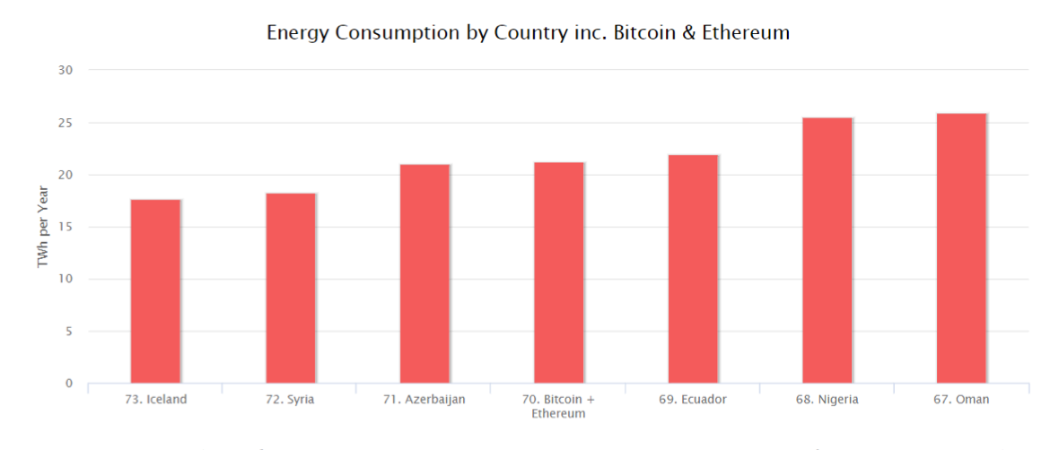
Proof-of-Work (PoW)
PoW requires agents to compete to update the blockchain. The competition consists of solving a trivial puzzle so that success probabilities depend on only raw computational power.
Notes:
There are different kinds of consensus mechanism algorithms which work on different principles.
The proof of work (POW) is a common consensus algorithm used by the most popular cryptocurrency networks like Bitcoin and Litecoin. It requires a participant node to prove that the work done and submitted by them qualifies them to receive the right to add new transactions to the blockchain. However, this whole mining mechanism of Bitcoin needs high energy consumption and longer processing time. Figure 1 ranks energy consumption by two PoW blockchains, Bitcoin and Ethereum, against that of all countries. The ﬁgure shows that Bitcoin and Ethereum collectively consume more energy on an annual basis than all but 69 countries individually. Separately, environmental researchers project that Bitcoin alone may overtake Denmark in energy consumption by 2020.

Slide 5
Proof-of-Stake (PoS)
In hopes of creating a sustainable permissionless blockchain (i.e. one that does not expend an exorbitant amount of energy), the blockchain community has bandied about several alternatives to PoW. The most frequently discussed alternative is a mechanism known as Proof-of-Stake (PoS).
PoS replaces PoW’s competition by oﬀering a randomly selected stakeholder the authority to update the blockchain; PoS thus omits any incentive for agents to engage in a computational arms race. Developers, however, remain reluctant to employ PoS because they fear that PoS fails to induce consensus. PoS, like PoW, oﬀers an agent an explicit monetary reward to update the blockchain, but PoS, unlike PoW, imposes no explicit cost upon agents to gain the authority to update the blockchain.
Notes:
The proof of stake (POS) is another common consensus algorithm that evolved as a low-cost, low-energy consuming alternative to POW algorithm. It involves allocation of responsibility in maintaining the public ledger to a participant node in proportion to the number of virtual currency tokens held by it.

Slide 6
Paper’s contribution:
1. Provide a formal economic model of PoS
-- subvert the Nothing-at-Stake problem
2. Demonstrates general conditions under which PoS leads to consensus.
Notes:
Within that model, subvert the Nothing-at-Stake problem thereby revealing PoS’s potential viability.

Slide 7
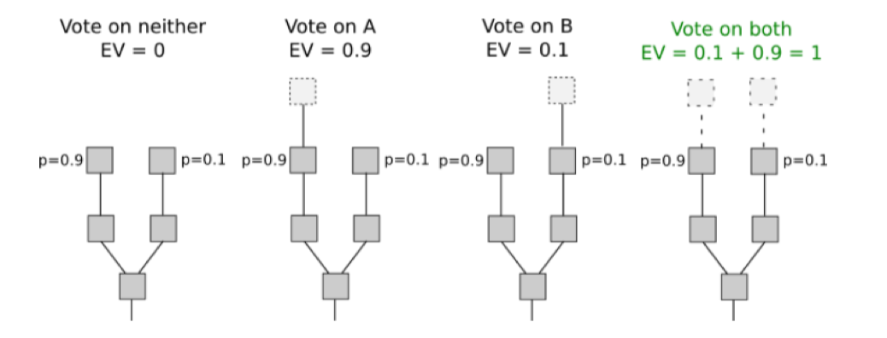
Nothing-at-Stake
Figure depicts the Nothing-at-Stake problem. One may view the act of appending to a branch of the blockchain as voting for that particular branch. The argument proceeds by asserting that appending blocks to all branches possible constitutes a weakly dominant strategy because all block rewards have non-negative value and agents obtain the right to append to the blockchain without expense.

Slide 8
Not Nothing-at-Stake
The Nothing-at-Stake problem alleges that players face no cost by deferring consensus. However, within a PoS protocol, all players with the ability to delay consensus own some coins, and delaying consensus reduces the value of those coins.
Two particular strategies:
Longest Chain Rule (hereafter referenced as the LCR), corresponds to a player appending only to the longest branch whenever feasible with the longest chain being deﬁned as branch 1 whenever both branches possess the same length.
Nothing-at-Stake strategy (hereafter referenced as the NSS), corresponds to a player appending a block whenever given the option in line with the Nothing-at-Stake problem.
Notes:
I use the remainder of this subσ σ section to subvert the Nothing-at-Stake problem.

Slide 9
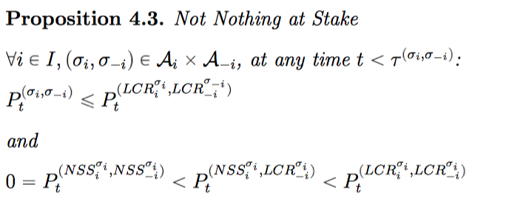
Proposition 4.3 avers that coin value obtains a maximum if all players follow LCR. As the blockchain achieves consensus at the earliest possible time when all players follow LCR, coin prices achieve a maximum in this case. Proposition 4.3 also states that following NSS instead of LCR when all other players follow LCR strictly reduces coin value. This ﬁnding undermines the Nothing-at-Stake problem as it establishes that following NSS imposes a cost upon stakeholders.
Notes:
Proposition 4.3 also asserts that all players following NSS causes coin price to achieve a minimum value of zero which further highlights that playing NSS imposes a cost upon players.

Slide 10
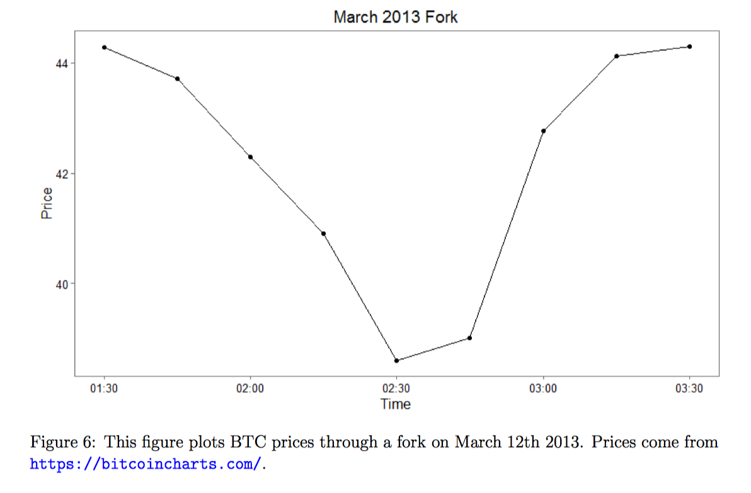
Notes:
Figure 6 provides empirical support. In March 2013, a fork arose on the Bitcoin blockchain, and the value of bitcoin collapsed as predicted by this section’s theory. Players reacted quickly and migrated to one branch. This migration created consensus and restored value.

Slide 11
Equilibrium Analysis
This sub-section demonstrates that PoS achieves consensus under general conditions.
-- show existence of an equilibrium in which PoS achieves consensus as soon as possible
-- show that all equilibria obtain consensus eventually.
If a player appends to the blockchain, she receives a block reward. This block reward possesses non-negative value, but appending to the blockchain may defer consensus and thus decrease coin value. A myopic player with no coins always appends to the blockchain when given the option if the block reward takes a positive value. Alternatively, a player with a large stake opts not to append to the blockchain when doing so defers consensus. Thus, an equilibrium in which all players follow the LCR exists if each player holds a suﬃcient stake.

Slide 12
Proposition 4.4 provides guidance to developers regarding designing a viable PoS blockchain. This proposition indicates that developers should restrict players with small stakes from appending to the blockchain. Having stake impels players to behave well. Moreover, the eligibility threshold for stake that ensures the existence of a symmetric LCR equilibrium depends upon the block reward level because a player must weigh her block reward against her pre-existing stake when deciding whether to append to the shorter branch.
Corollary 4.5 highlights a trivial but important insight: a permissionless blockchain need not possess a block reward. This result arises because a player incurs a cost for delaying consensus but receives no oﬀ-setting reward for appending to the blockchain’s shorter branch. If a player refuses to append to the blockchain’s longer branch when all other players play LCR then she delays consensus and thereby undermines her own wealth. If a player appends to the blockchain’s shorter branch when all other players play LCR then she also undermines her own wealth by delaying consensus, but she receives no block reward to counteract her loss.

Slide 13
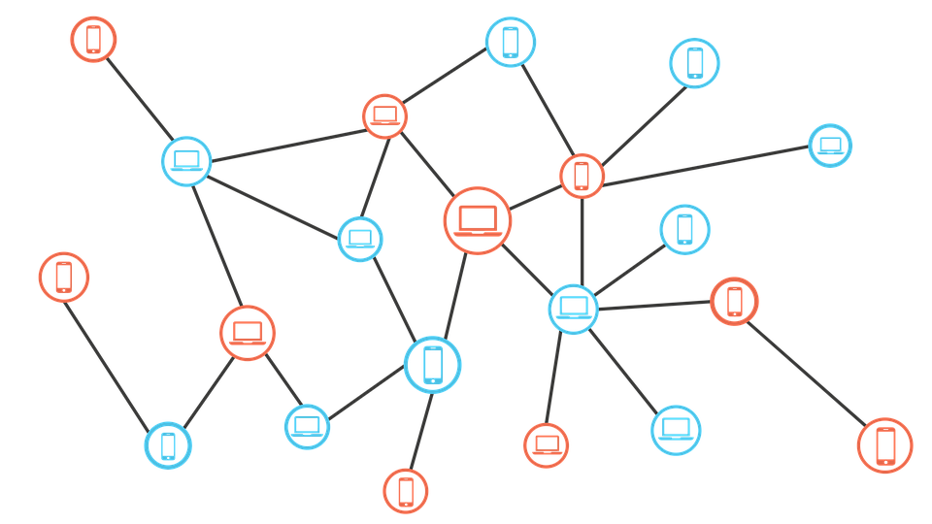

Slide 14
Conclusion
This paper provides a formal economic analysis of PoS and it demonstrates that PoS achieves consensus under general conditions. Therefore, developers may implement a viable permissionless blockchain without prohibitive energy consumption.

Slide 15
My Opinion

Slide 16
Thank you!

